Slide 1


Notes:
LYNN
1 – Introduce Ourselves
2 – The Research Quest Story
- Began in 2013
- Goals – Overarching goal was to develop an easy to access investigation that would allow students to learn to think critically
- Funding
- Easy to Use – Fun for Students

Slide 2
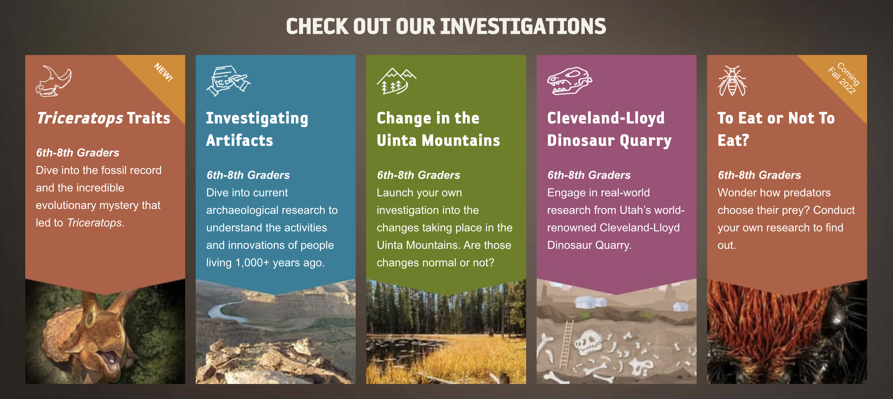
Notes:
LYNN
- Review the various investigations and a brief summary
- Note they are all setup in very similar ways
- They use different museum artifacts and allow teachers to select even a portion of the larger investigations for students to use

Slide 3
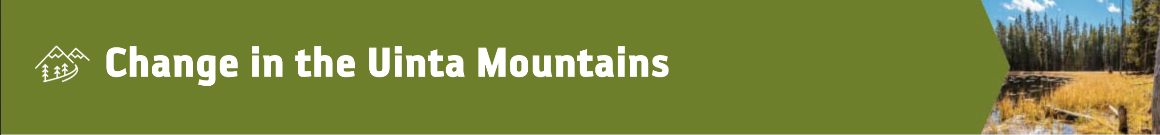
5th Grade Standards
6th Grade Standards
5.3.2 - Obtain, evaluate, and communicate information that animals obtain energy and matter from the food they eat for body repair, growth, and motion and to maintain body warmth.
5.3.3 - Develop and use a model to describe the movement of matter among plants, animals, decomposers, and the environment.
5.3.4 - Evaluate design solutions whose primary function is to conserve Earth’s environments and resources.
6.4.1 - Analyze data to provide evidence for the effects of resource availability on organisms and populations in an ecosystem. Ask questions to predict how changes in resource availability affects organisms in those ecosystems.
6.4.2 - Construct an explanation that predicts patterns of interactions among organisms across multiple ecosystems. Emphasize consistent interactions in different environments such as competition, predation, and mutualism. (LS2.A)
6.4.3 - Develop a model to describe the cycling of matter and flow of energy among living and nonliving parts of an ecosystem.
6.4.4 - Construct an argument supported by evidence that the stability of populations is affected by changes to an ecosystem.
Notes:
QUICKLY REVIEW THE STANDARDS THAT ARE HIT BY THE INVESTIGATION

Slide 4
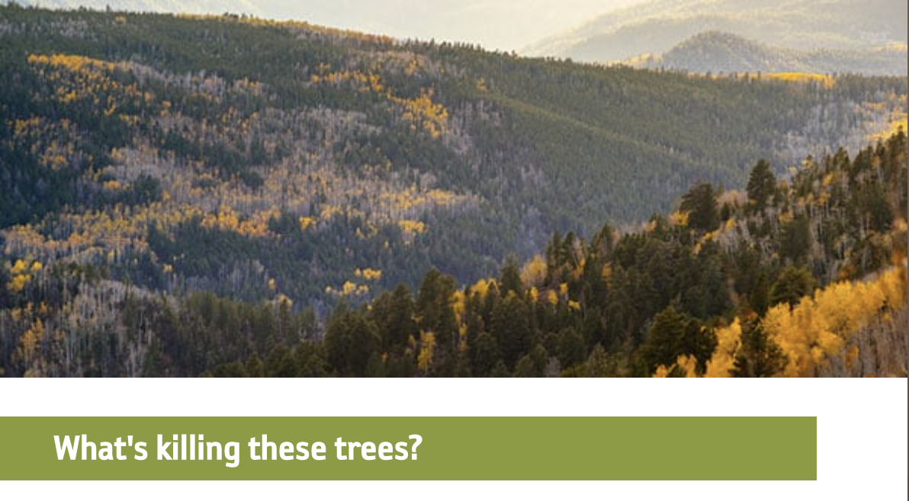
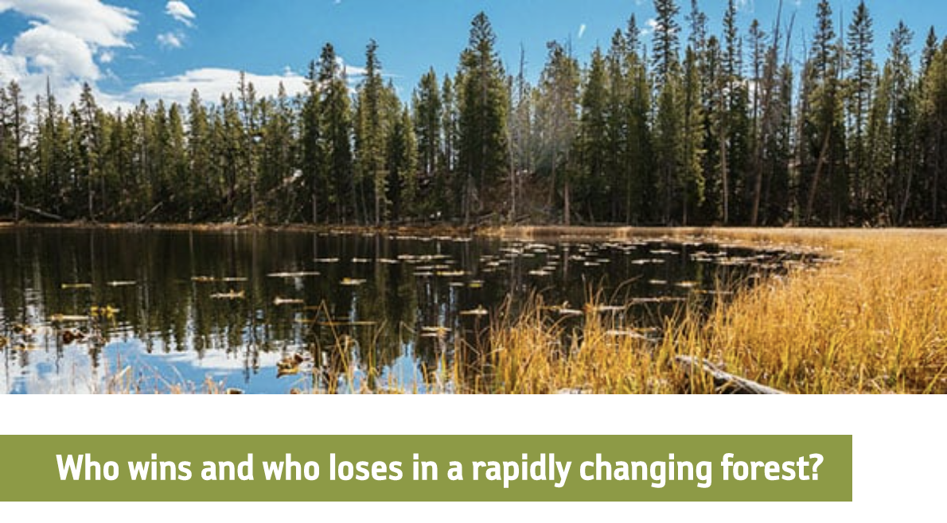
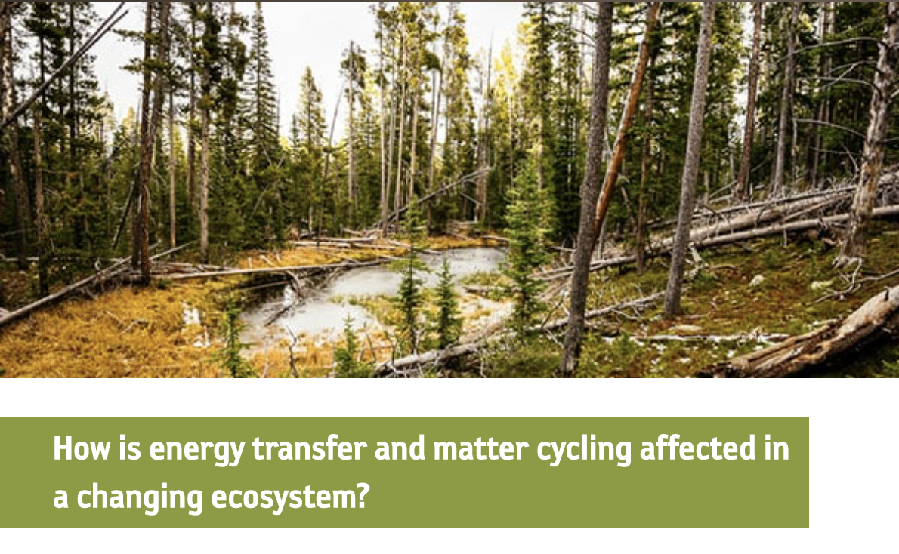
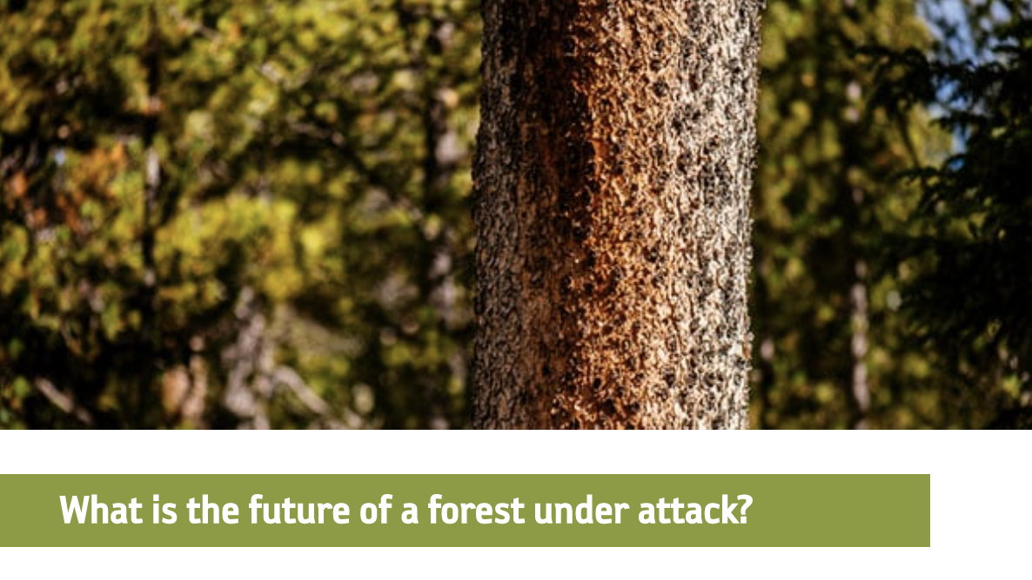
Go To:
researchquest.org
Access Code:
[INSERT YOUR UNIQUE STUDENT ACCESS CODE]
Notes:
LYNN
- Get participants to a Research Quest as if they were students in our class
- Kind of like seeing it in reverse (student view/experience first – then teacher view a little later)

Slide 5
COMMUNICATE
INTERPRET
GATHER
ANALYZE
Notes:
LYNN
- Each part of the investigation follows this similar pattern
- Gather – Analyze – Interpret – Communicate
- Remembering that the overall goal is to help students think more critically about the world around them using the data they have

Slide 6

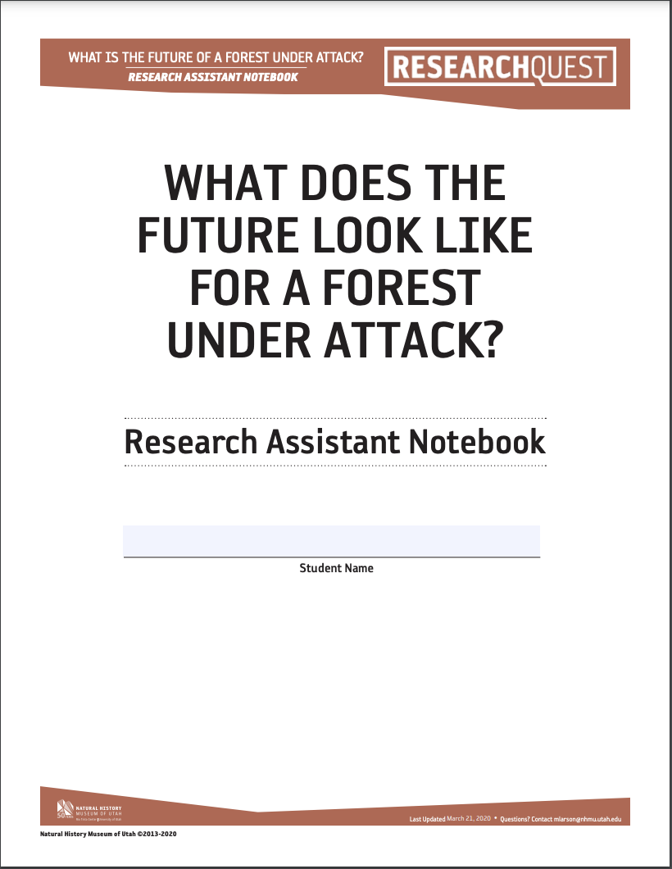
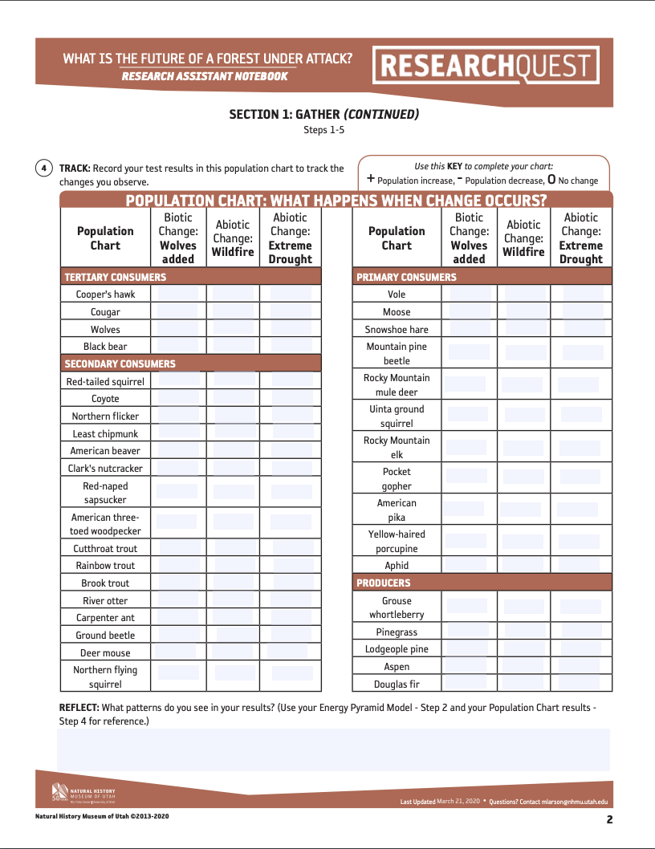
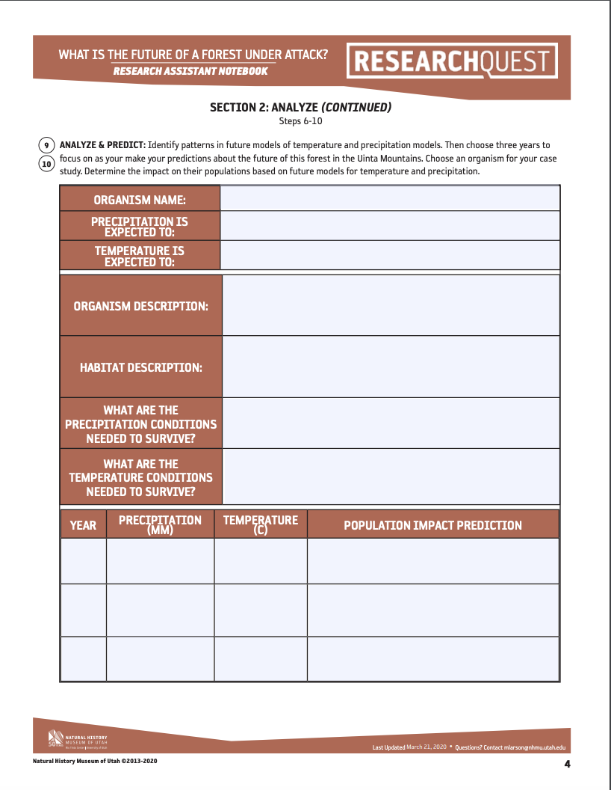
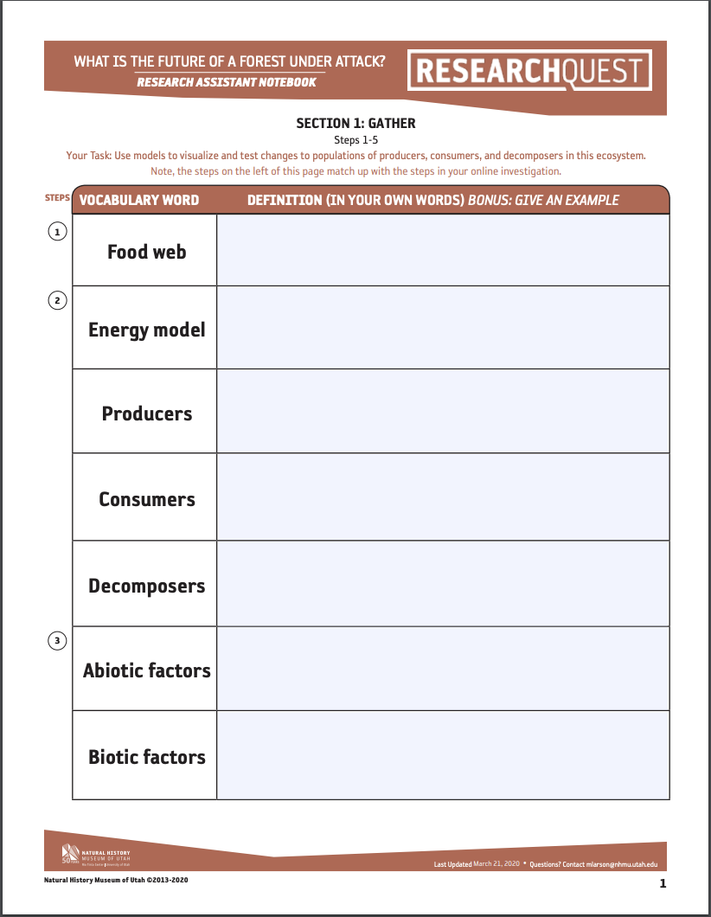
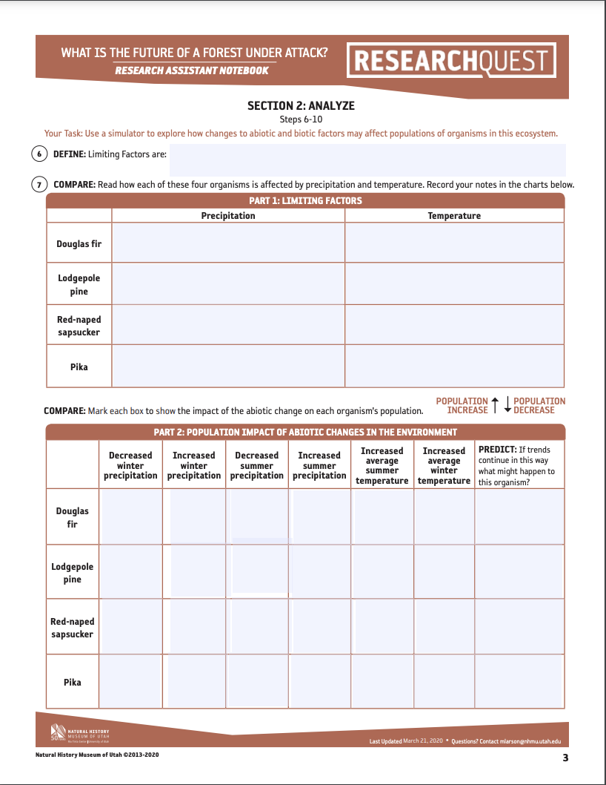
Investigation Snapshot!
STEPS 1-5
Notes:
RACHAEL
- Investigation – Part 1 – Steps 1-5

Slide 7
Investigation Snapshot!
STEPS 6-10
Notes:
RACHAEL
- Investigation – Part 2 – Steps 6-10

Slide 8
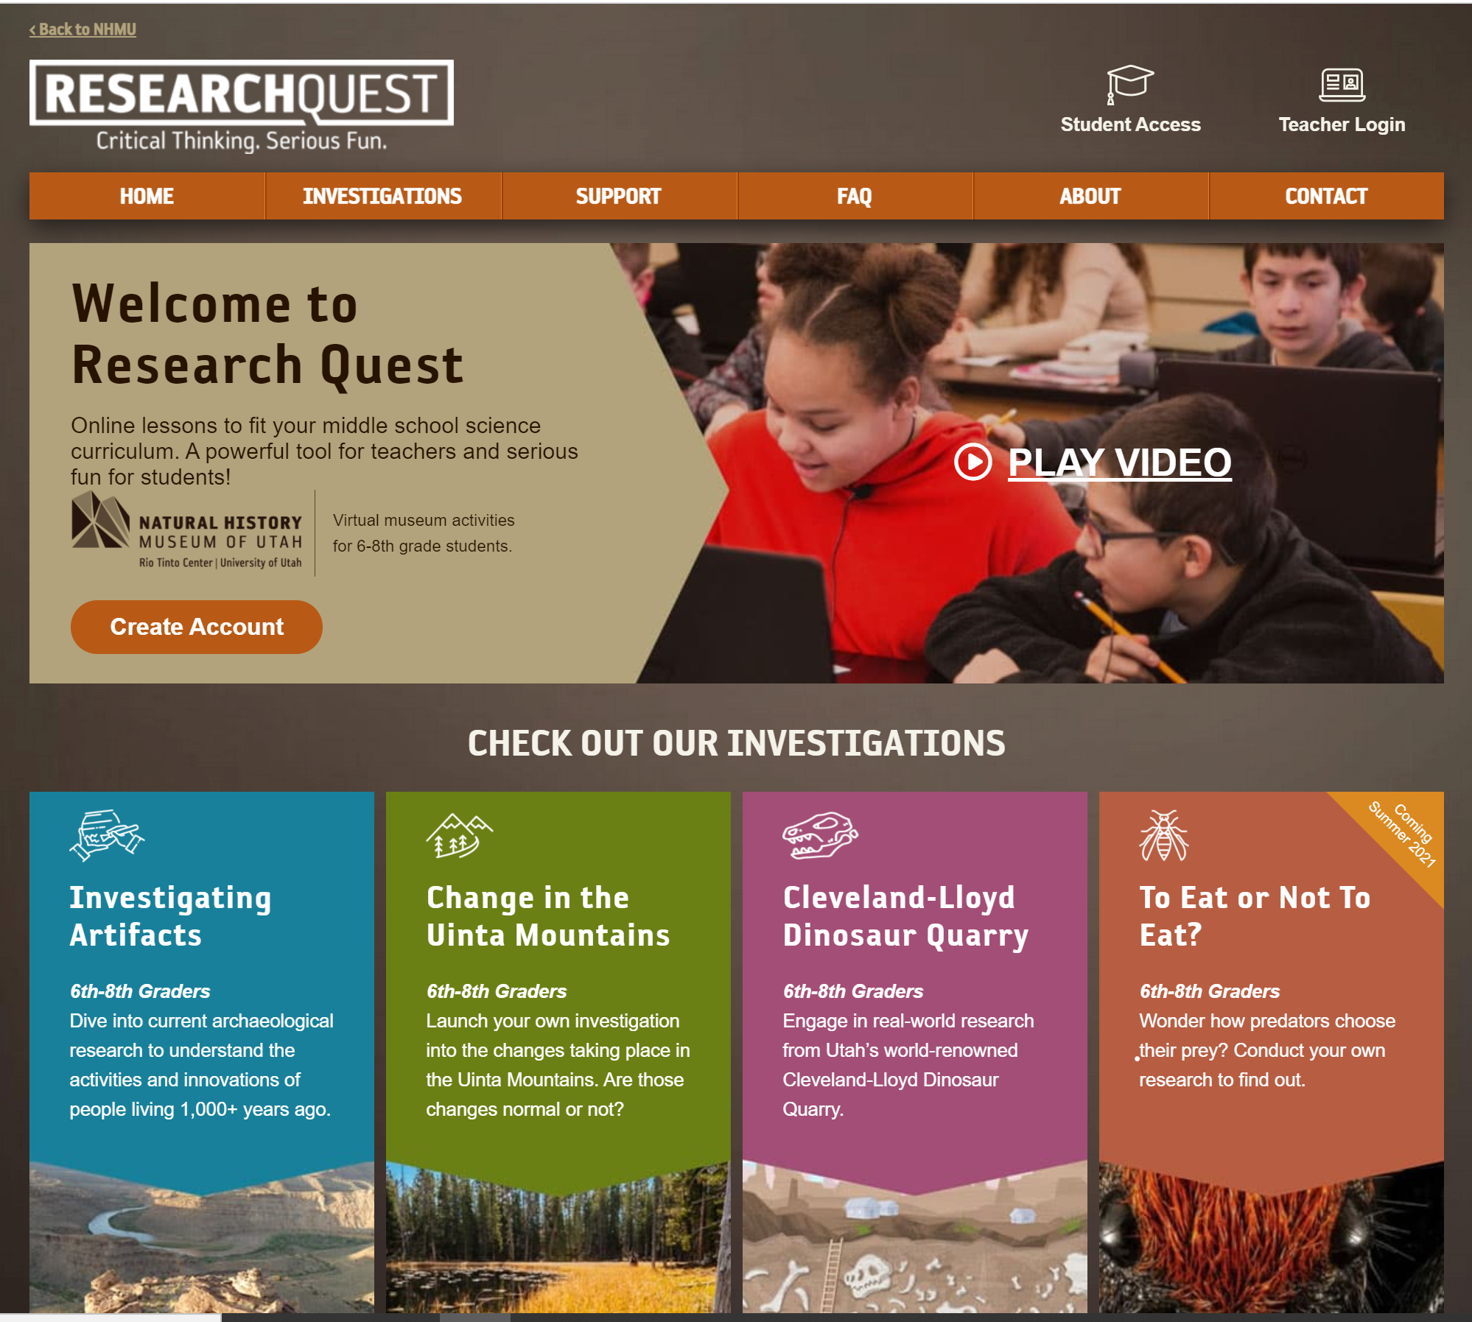

Check out ALL the Research Quest content!
Create a free teacher account today!
[INSERT YOUR EMAIL OR CONTACT INFO HERE]
Notes:
Original Authors:
Rachael Coleman rachael.coleman@jordandistrict.org
Lynn Gutzwiller lynn.gutzwiller@jordandistrict.org
- Support teachers as they create an account, explore various investigations, and ask questions.

